Slide 1

SDET Course
Design Patterns - Memento

Slide 2
3 Types of Design Patterns
Creational
Singleton
Builder
Prototype
Factory Method
Abstract Factory
Structural
Adapter
Composite
Proxy
Flyweight
Bridge
Facade
Decorator
Behavioral
Strategy
Observer
Command
Memento
State
Template Method
Mediator
Chain of Responsibility
Interpreter
Visitor
Iterator

Slide 3
Agenda
Description
Diagram
Code sample (Java)
Use cases

Slide 4

Description
Introduction - Memento

Slide 5
Description
The Memento Design Pattern is a behavioral design pattern that provides the ability to restore an object to its previous state without revealing the details of its implementation. This pattern is particularly useful in scenarios where direct access to the object's internal state is not desirable or violates encapsulation, such as in undo mechanisms or snapshot-style save points. The pattern involves three key roles: the Originator, which is the object whose state needs to be saved and restored; the Memento, which is a lightweight representation of the Originator's state at a particular time; and the Caretaker, which requests a save from the Originator and holds onto the Memento until a rollback is required. This separation of concerns allows for the internal state of the Originator to be saved and restored externally by the Caretaker, without compromising the principles of encapsulation and internal structure of the Originator.

Slide 6
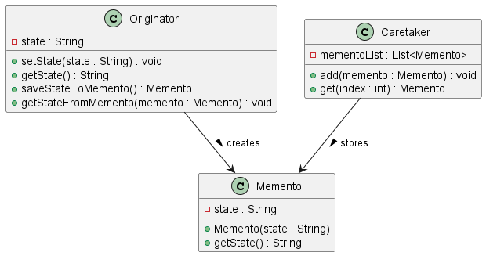
Class Diagram

Slide 7
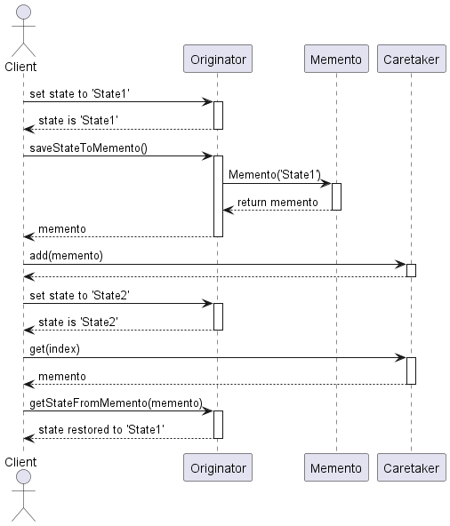
Sequence Diagram

Slide 8
Code Sample

Slide 9
Use cases
General
State Management in Workflows
Undo Mechanisms
Version Control
In Test Automation
Multi-state Scenario Testing
Isolation Testing
Pathway Testing
Regression Testing

Slide 10
Happy Coding

